Slide 1
Updated Good Publication Practice (GPP) for Company-Sponsored Research GPP 2022: Key Questions
Lisa DeTora, PhD (gpp2022@ismpp.org)
Hofstra University, Hempstead NY USA

Slide 2
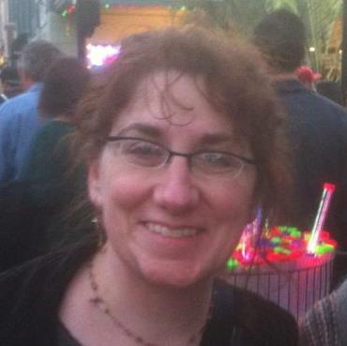
Speaker: Lisa DeTora
In the past 12 months, I was a paid employee/consultant of Hofstra University, Harvard Medical School, the Regulatory Affairs Professional Society, and Boston University
The opinions expressed are mine
About me
20 + years’ experience in Clinical Development, Medical and Scientific Affairs
Currently lead health communication at Hofstra University
Specialist in scientific writing, publications ethics, rhetoric of science, technology and medicine, medical humanities
Lead author of GPP 2022 and head of GPP Steering Committee

Slide 3
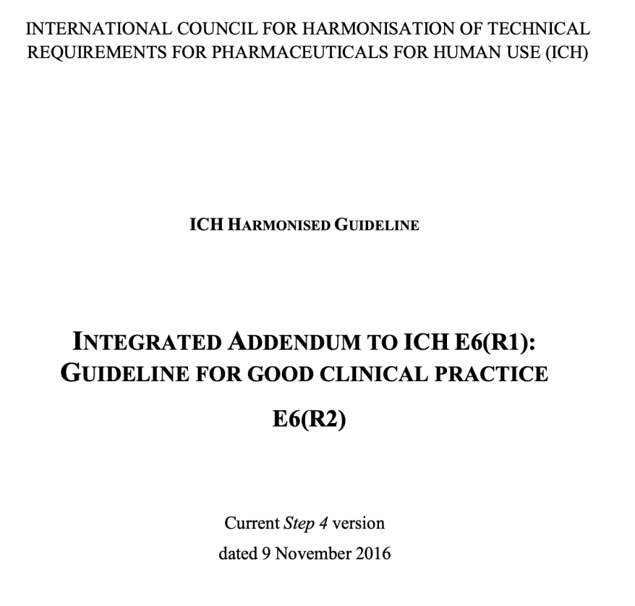
What is Good Publication Practice (GPP)?
Modelled on Good Clinical Practice (ICH E6; www.ich.org)
Describes good practices for publishing: transparency, authorship, ethics
For specific issues in company-sponsored research and adopted by companies and medical communication agencies worldwide
Most recent update in Annals of Internal Medicine https://pubmed.ncbi.nlm.nih.gov/36037471/ FREE to download

Slide 6
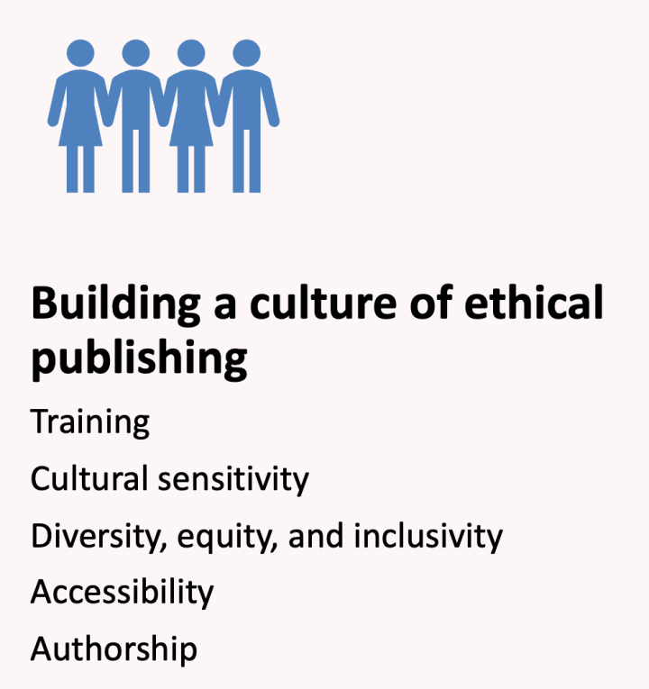
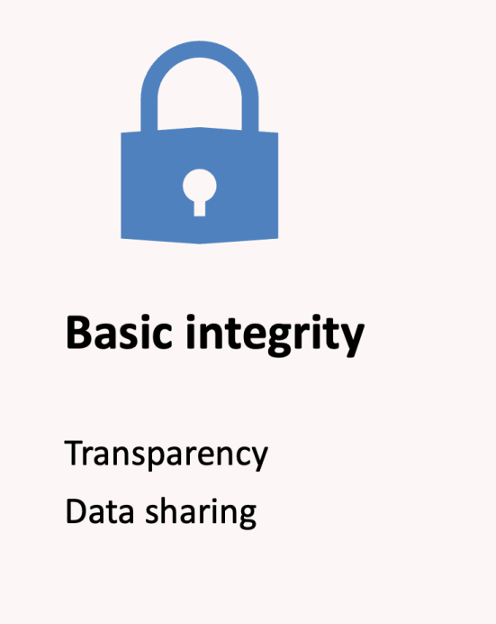
Key ongoing questions

Slide 7
Building a culture of ethical publishing with GPP 2022
Supplemental sections can be used for training and communication
Cultural sensitivity
Japanese translation on track for 2023
Chinese character translation available at: https://www.ismpp.org/gpp-2022 FREE to access
Diversity, equity and inclusivity
Extends to all areas of publications—consider patients, regional colleagues, other criteria
More work to be done: research, education and funding come long before publications
Accessibility
Includes enhanced content, plain language summaries
Consider translations
Consider technology, audio, video, literacy
Steering Committees
Publication Process
Authorship
Language not enough

Slide 8
Mini-case: Authorship
The International Committee of Medical Journal Editors (ICMJE; http://icmje.org) edited authorship criterion #2
Authors must “review” text for critical content and have an opportunity to revise if needed
Reduces authorship burden
Increases access and inclusion for colleagues who speak different languages
GPP 2022 remains the same
Living document
Written to remain durable with changes to other guidelines

Slide 9
Integrity in research publications
Follows from major research guidelines
Declaration of Helsinki (https://www.wma.net/policies-post/wma-declaration-of-helsinki-ethical-principles-for-medical-research-involving-human-subjects/)
International Council for Harmonisation (https://www.ich.org/page/ich-guidelines)
GPP 2022
Supports a larger framework of ethics and integrity
Enables authors to be more ethical in publishing company-sponsored research

Slide 10
Ongoing questions: Who is working on answers for companies? A few examples
International Society for Medical Publication Professionals (https://www.ismpp.org)
Drug Information Association (https://www.diaglobal.org)
American Medical Writers Association (https://www.amwa.org)
European Medical Writers Association (https://www.emwa.org)
Japan Medical and Scientific Communication Association (http://jmca-npo.org/index.html)
Regulatory Affairs Professional Society (https://www.raps.org)
Contact us with questions... gpp2022@ismpp.org

Slide 11
GPP brings regulatory practices and research ethics into better alignment with journal guidelines

Slide 12
GPP 2022 Authoring Team
Dan Bridges, Lise Baltzer, Leslie Citrome, Lisa DeTora, Faith Di Biasi, Laura Dormer, Eline Hanekamp, Trevor Lane, Fiona Plunkett, Angela Sykes, Dikran Toroser, Christine Vanderlinden
No financial support was received for participation in the “GPP 4” Steering Committee or contributing to GPP 2022

Slide 13
GPP, Good Publication Practice; HEOR, health economics and outcomes research; ISMPP, International Society for Medical Publication Professionals; PLS, plain language summary; RWE, real-world evidence. https://www.acpjournals.org/doi/full/10.7326/M22-1460
Please note: Slides adapted from materials courtesy of Nucleus Global, An Inizio Company prepared for ISMPP U

Slide 14
Questions and contact: gpp2022@ismpp.org

